Slide 1

The Christian Walk
GES 2O2O

Slide 2

Various Views on the Victorious Christian Walk

Slide 3

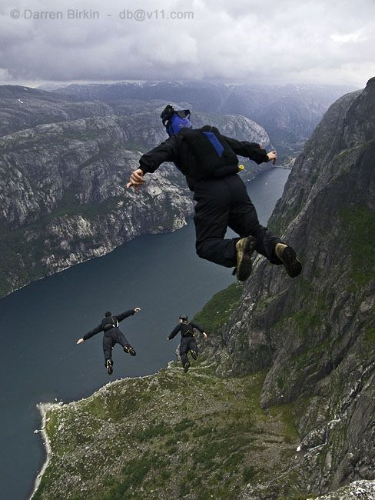
\
#1 The Adrenaline Rush.
Various Views

Slide 4
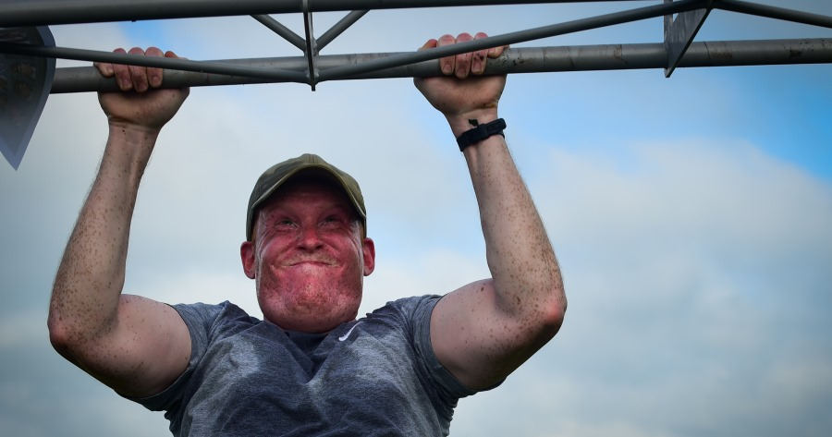
#2 We try harder
Various Views

Slide 5
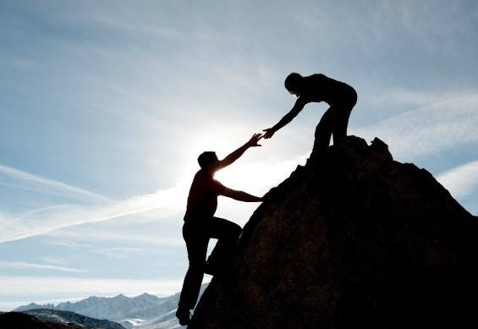
#3 Don’t Try, rely
Various Views

Slide 6

#4
Practicing spiritual disciplines
Various Views

Slide 7
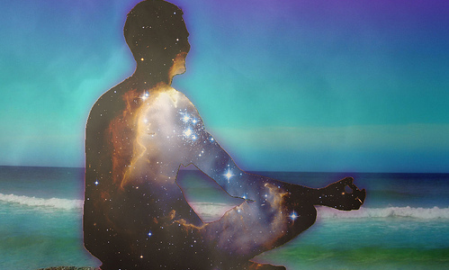
#5
Practicing CONTEMPLATIVE Spirituality and Spiritual Formation
Various Views

Slide 8
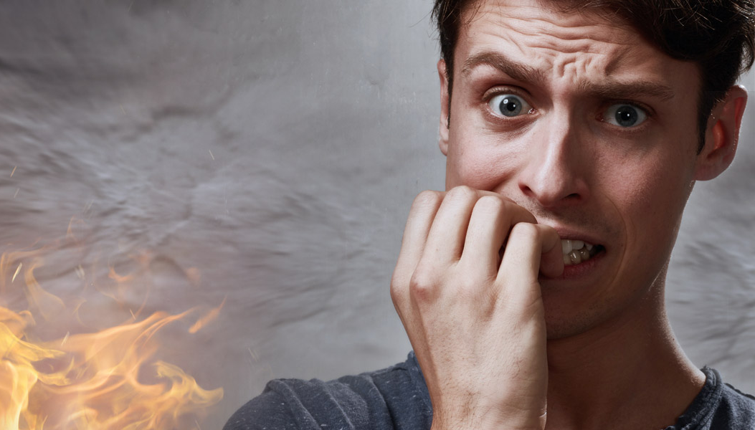
#6
The FEAR OF HELL approach
Various Views

Slide 9
Weakness with these views

Slide 10

#1 Burn out likely
Weaknesses

Slide 11
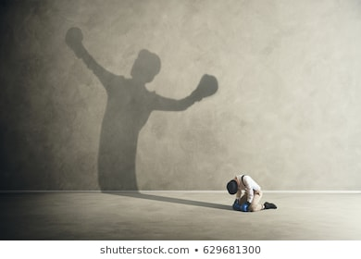
#2
spiritual pride results in spiritual defeat
Weaknesses

Slide 12

#3 Difficulties in life
Weaknesses

Slide 13
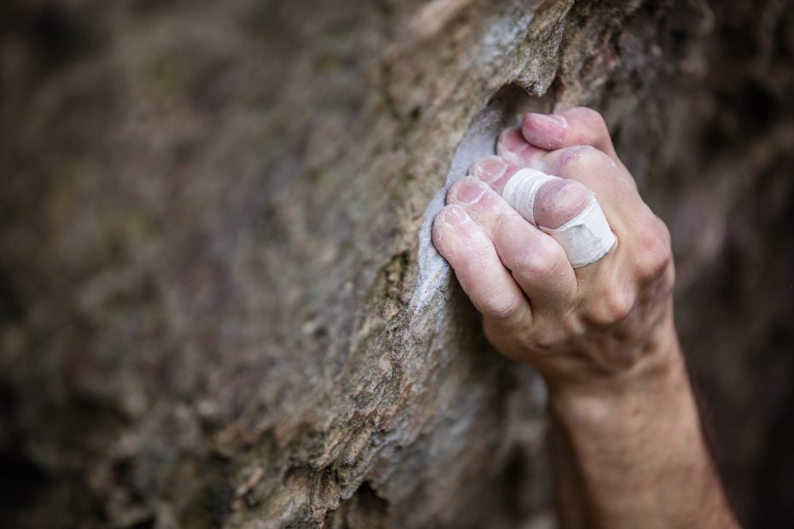
#4
You can not let go
Weaknesses

Slide 14

#5
legalism is ineffective
Weaknesses

Slide 15
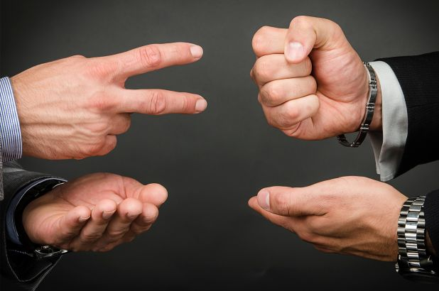
#6
moving away from objective truth into subjective experience
Truth
Experience
Weaknesses

Slide 16
#7
Fear of hell does not promote love and gratitude
Weaknesses

Slide 17
The Romans 12:2 View on the Victorious Christian Walk

Slide 18

What Is the Proper Mindset ?

Slide 19
What Is the Proper Mindset ?
#1 Holding fast to the gospel
(1 Cor 15:2).

Slide 20
What Is the Proper Mindset ?
#2 Pressing on toward the prize (Phil 3:10-13).

Slide 21
Laying up treasure in heaven (Matt 6:19-21)
Fighting the good fight (2 Tim 4:6-8)
Running with eyes on the finish (2 Tim 4:6-8)
Keeping the faith (2 Tim 4:6-8)
#2 Pressing on towards the prize

Slide 22
What Is the Proper Mindset ?
#3 Being watchful for Christ’s soon return

Slide 23
What Is the Proper Mindset ?
#4 Fearing shame at the Bema (1 John 2:28)

Slide 24
What Is the Proper Mindset ?
#5 Looking to Jesus

Slide 25
What Is the Proper Mindset ?
#6 An attitude of gratitude

Slide 26
What Is the Proper Mindset ?
#7 The blessedness of suffering for Christ

Slide 27

Where Do We Get This Proper Mindset?
i. Our local church

Slide 28
Where Do We Get This Proper Mindset?
ii. Godly examples

Slide 29
Where Do We Get This Proper Mindset?
iii. Personal Bible study

Slide 30
Where Do We Get This Proper Mindset?
iv. Life

Slide 31

What Is Needed Beside the Proper Mindset (Jas 2:14-26)?

Slide 32
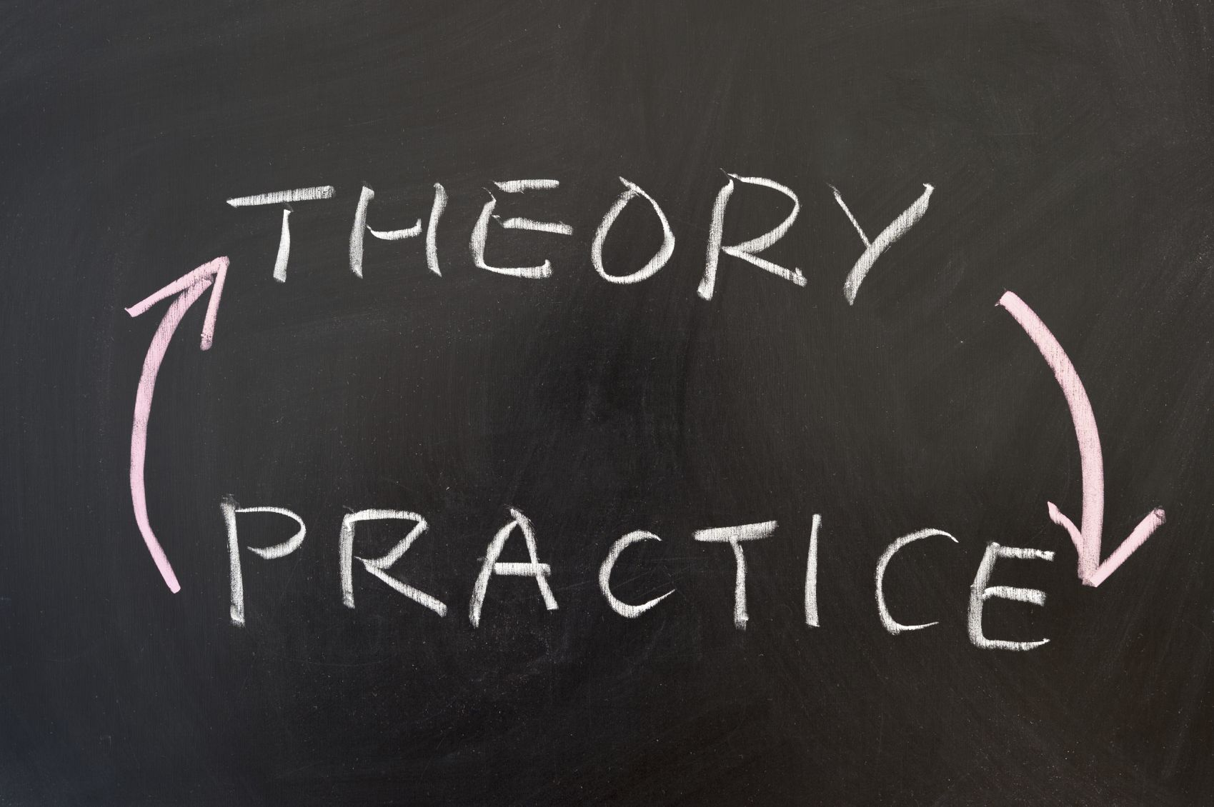
Our mindset, what we believe, must be put into practice.
Christian Walk

Slide 33

ii. Faith without works is useless.
Christian Walk

Slide 34
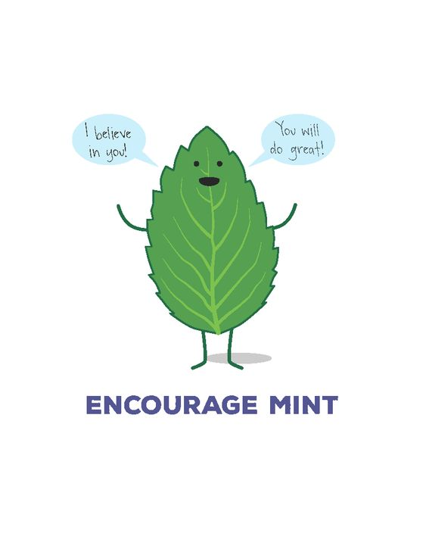
iii. The encouragement and exhortation of others
Christian Walk

Slide 35

iv. Walking by faith, not by sight (2 Cor 5:7)
Christian Walk

Slide 36

v. Paying attention to our minds and bodies (2 Cor 5:1-11)
Christian Walk

Slide 37

Comparison with Six Secrets

Slide 38
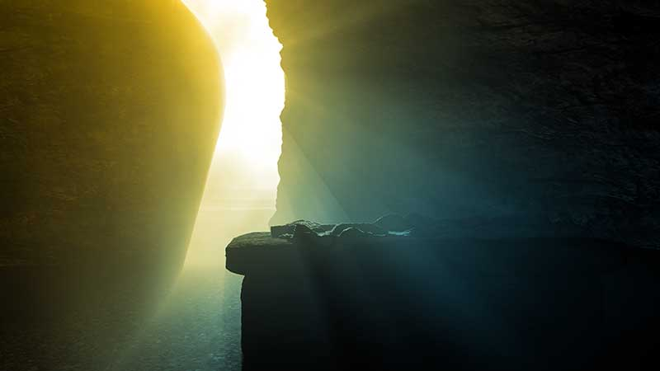
Secret #1: The miracle of resurrection (Rom 8:10-11).
Six Secrets

Slide 39
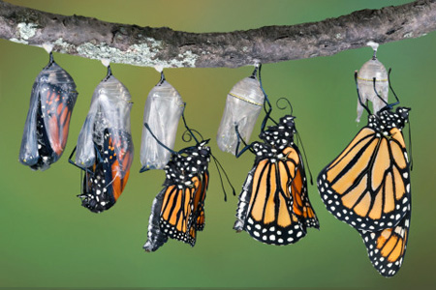
Secret #2: The miracle of transformation (2 Cor 3:18).
Six Secrets

Slide 40
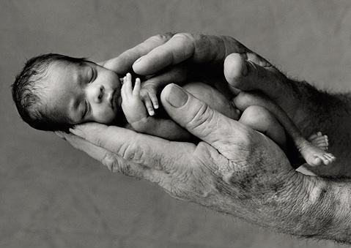
Secret #3: The miracle of our born-of-God self (Jas 1:22-24).
Six Secrets

Slide 41

Secret #4: The miracle of the light (1 John 1:6-7).
Six Secrets

Slide 42
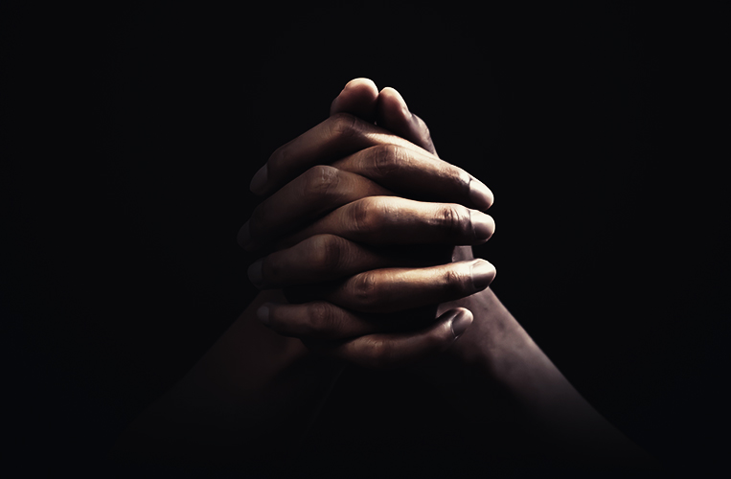
Secret #5: The miracle of prayer (1 John 5:14-15).
Six Secrets

Slide 43

Secret #6: The miracle of a spiritual mindset (Rom 8:5-6).
Six Secrets

Slide 44
I think three things characterize all believers who are living victoriously:

Slide 45
They are humble (Jas 4:6; 1 Pet 5:5). 2. They love the Lord Jesus Christ (2 Cor 5:4). 3. They believe the faith-alone message (Gal 5:4).

Slide 46
Victorious believers are spiritually minded.

Slide 47
Questions/Answers

