Slide 1
The Word of God
Ten Theses and 4 Applications
By Shawn Lazar

Slide 2
I started reading the Bible when I was around sixteen…

Slide 3
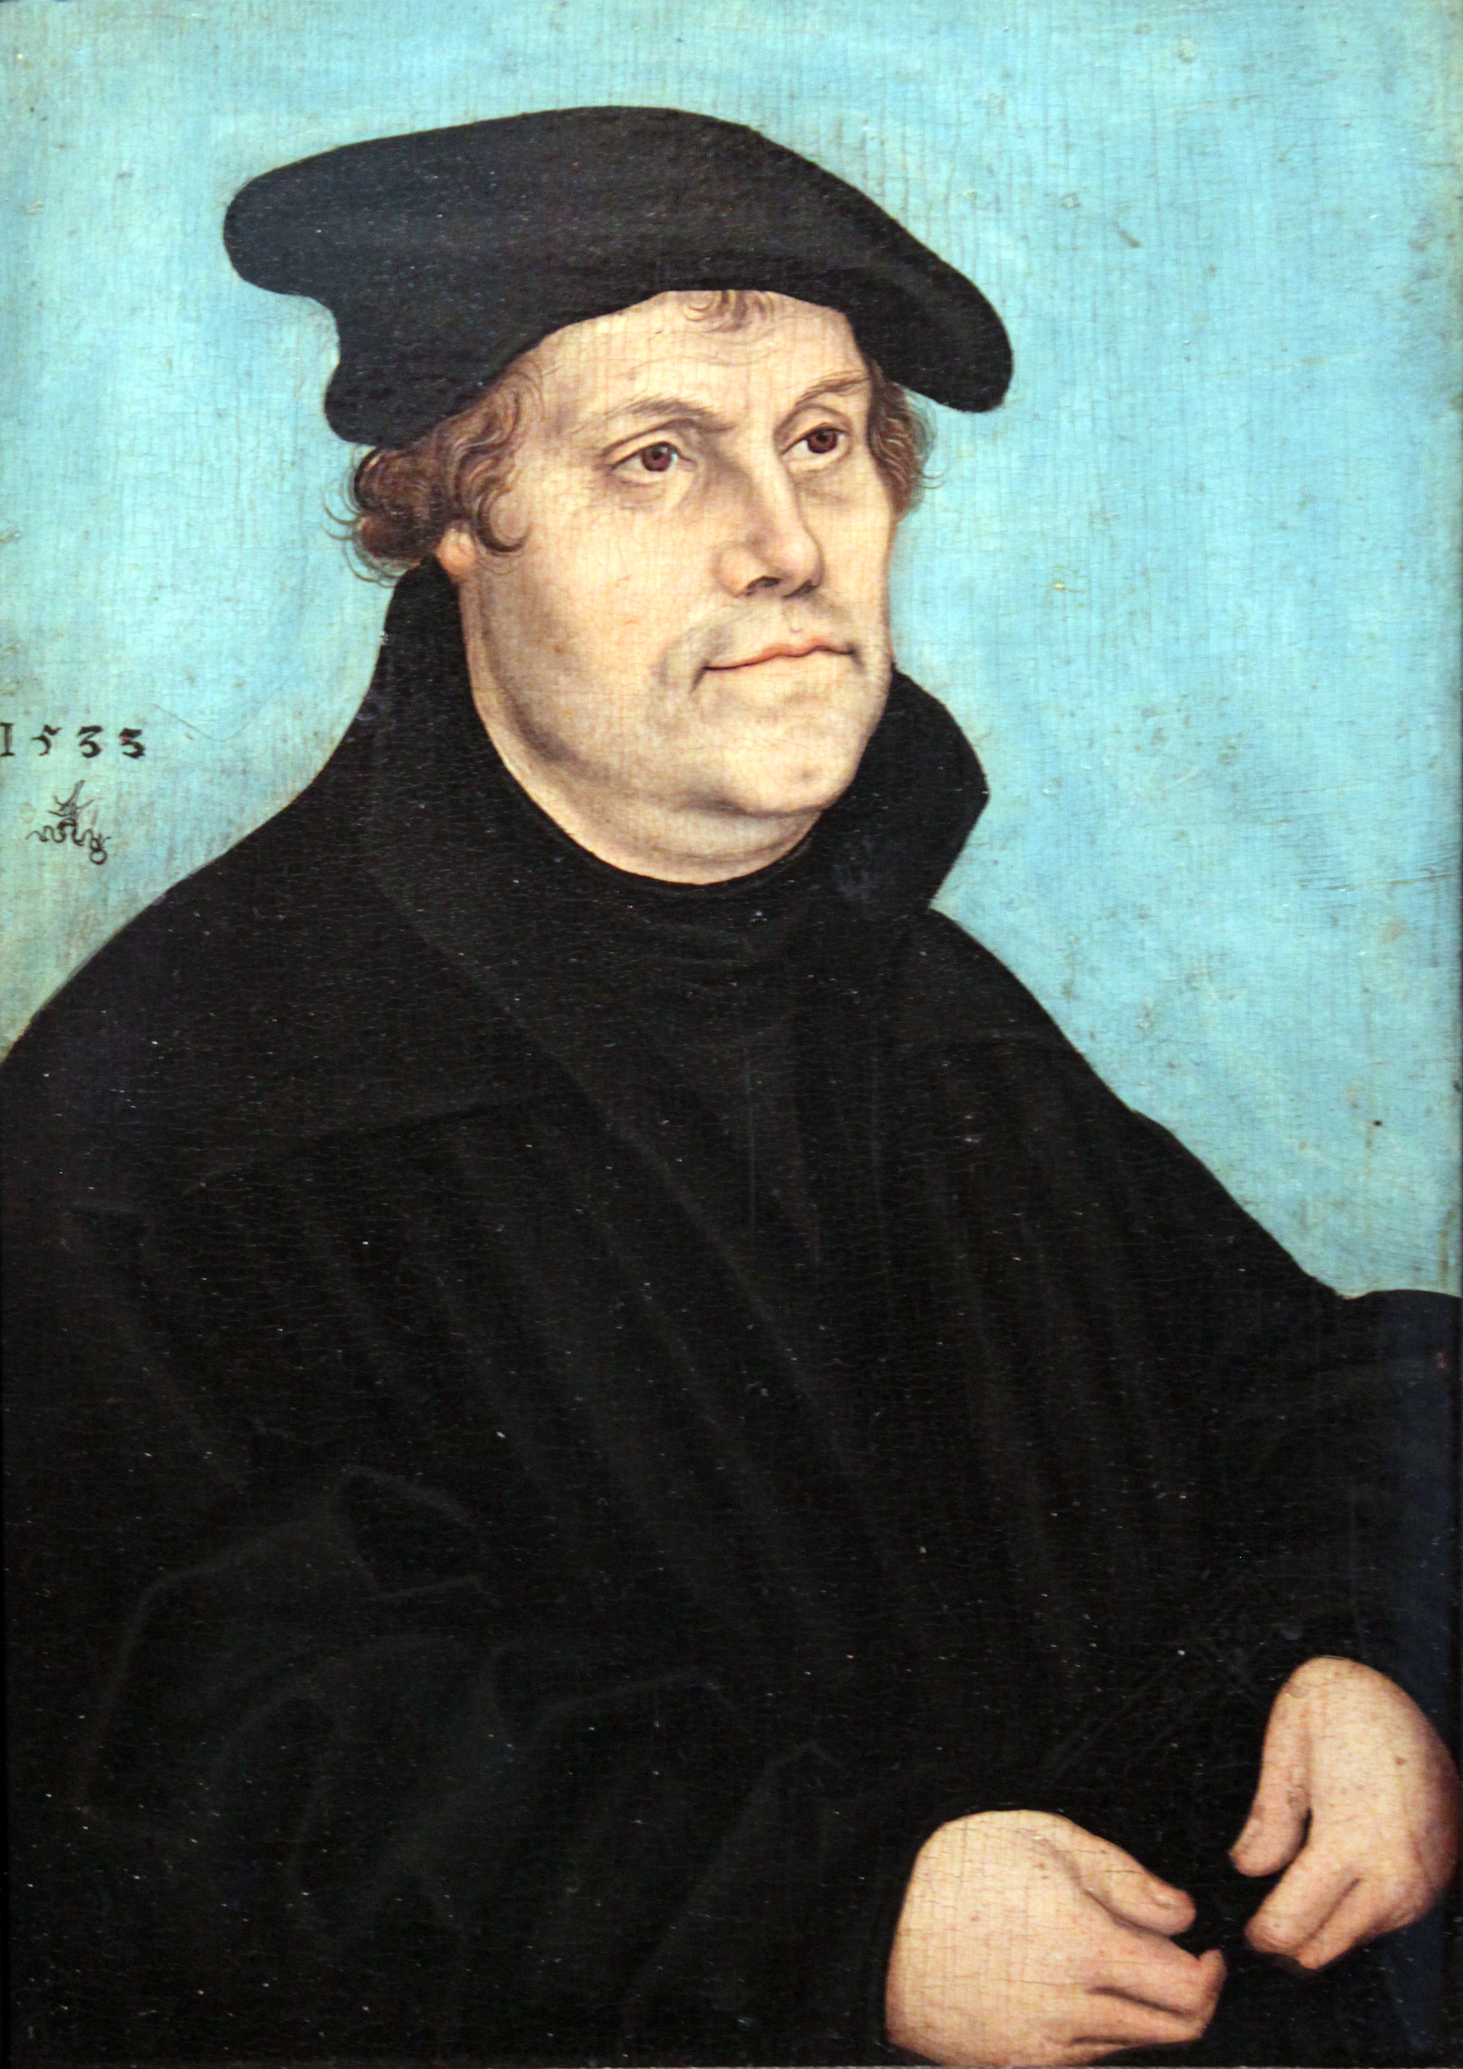
Martin Luther
“We must make a great difference between God's Word and the word of man. A man's word is a little sound, that flies into the air, and soon vanishes; but the Word of God is greater than heaven and earth, yea, greater than death and hell, for it forms part of the power of God, and endures everlastingly” (Table Talk 44).

Slide 4
What is Bibliology?
BIBLIOLOGY is the study of the Bible,
the Word of God.

Slide 5
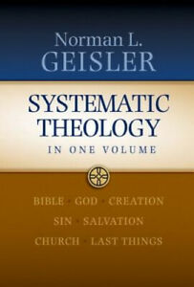
Many systematic theologies
do not have a separate section on Bibliology, but they should. However, Geisler’s has 200+ pages on the subject.

Slide 6
Quick facts about the Bible
66 books; three languages; written over 1400-1800 years; by 40+ human authors, and 1 divine author.

Slide 7
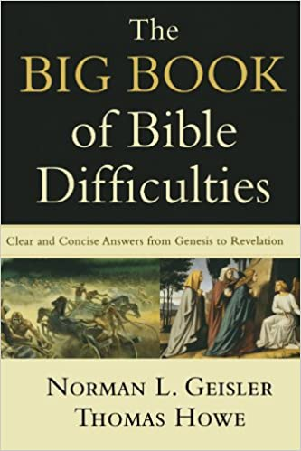
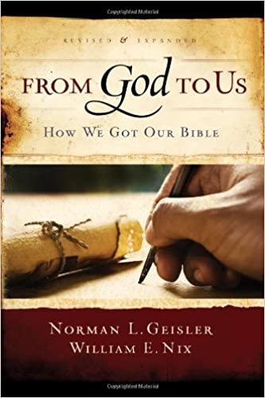
I will NOT be covering…
Apologetics
The Canon Issue
Which books belong in the Bible
The reliability of the Bible

Slide 8

I will do a constructive presentation of what the Bible claims for itself.

Slide 9
Ten Theses about the Word of God

Slide 10
Thesis 1: God speaks.
By the word of the Lord the heavens were made,
And by the breath of His mouth all their host.
He gathers the waters of the sea together as a heap;
He lays up the deeps in storehouses.
Let all the earth fear the Lord;
Let all the inhabitants of the world stand in awe of Him.
For He spoke, and it was done;
He commanded, and it stood fast (Ps 33:6-9).

Slide 11
Thesis 1: God speaks.
The difference between grunting and speaking, is that speaking communicates propositional information.
The fact that God speaks tells us that He is a person who has a mind, who thinks, reasons, and relates.

Slide 12

Thesis 1: God speaks.
By contrast…
What profit is the idol when its maker has carved it, or an image, a teacher of falsehood?
For its maker trusts in his own handiwork
When he fashions speechless idols (Hab 2:18-20).

Slide 13
Thesis 2: God spoke to men.
Then the Lord said to Moses…God spoke further to Moses (Exod 6:1-2).
Then God spoke all these words, saying… (Exod 20:21).
Then You came down on Mount Sinai, And spoke with them from heaven; You gave them just ordinances and true laws, Good statutes and commandments (Neh 9:13).

Slide 14
Thesis 3: God inspired men to speak.
Then the Lord stretched out His hand and touched my mouth, and the Lord said to me, “Behold, I have put My words in your mouth” (Jer 1:9).
“I will raise up a prophet from among their countrymen like you, and I will put My words in his mouth, and he shall speak to them all that I command him” (Deut 18:18).
“I did not speak on My own initiative, but the Father Himself who sent Me has given Me a commandment as to what to say and what to speak. I know that His commandment is eternal life; therefore the things I speak, I speak just as the Father has told Me” (John 12:49-50).

Slide 15
Thesis 4: God inspired men to write.
  All Scripture is breathed out by God and profitable for teaching, for reproof, for correction, and for training in righteousness (2 Tim 3:16 ESV).
“The Biblical revelation, the message that was breathed out by God, is a written revelation. The idea is not, or at least not merely, that the prophets were inspired. It is true, of course, that they were borne along by the Holy Spirit; but the Biblical claim is that God inspired what was written” (Gordon Clark, God’s Hammer, 11).

Slide 16
Thesis 4: God inspired men to write.
Everything that God speaks, is inspired, but not all inspired speech is Scripture.
Think about Jesus. If Jesus spoke an average of 130 words a minute, for three hours a day, over the course of three years, He would have spoken over 23,000,000 inspired words. You could make 130 books of 500 pages each with that many words. As John said:
  And there are also many other things that Jesus did, which if they were written one by one, I suppose that even the world itself could not contain the books that would be written. Amen (John 21:25).

Slide 17
Thesis 4: God inspired men to write.
Peter considered Paul’s letters to be as inspired as the Old Testament:
    and consider that the longsuffering of our Lord is salvation—as also our beloved brother Paul, according to the wisdom given to him, has written to you, as also in all his epistles, speaking in them of these things, in which are some things hard to understand, which untaught and unstable people twist to their own destruction, as they do also the rest of the Scriptures (2 Pet 3:15-16).

Slide 18
Thesis 5: What the Bible says, God says.
    “For Moses said, ‘Honor your father and your mother’; and, ‘He who curses father or mother, let him be put to death.’ But you say, ‘If a man says to his father or mother, “Whatever profit you might have received from me is Corban”—’ (that is, a gift to God), then you no longer let him do anything for his father or his mother, making the word of God of no effect through your tradition which you have handed down. And many such things you do”” (Mark 7:10-13).

Slide 19
Thesis 6: The verb tense is inspired.
To prove bodily resurrection, Jesus quoted from Exod 3:6, when God spoke to Moses out of the burning bush:
    “I am the God of your father, the God of Abraham, the God of Isaac, and the God of Jacob.”
How does that verse prove bodily resurrection?

Slide 20
Thesis 6: The verb tense is inspired.
If Abraham was dead and gone, God could have said, “I was the God of Abraham,” past tense. Jesus sets up a syllogism:
  P1: God “is not the God of the dead but of the living” (Matt 22:32).
  P1: God is the God of Abraham (present tense).
  C: Therefore, Abraham must be living.
In any case, Jesus’ argument turned on the inspiration of the verb tense.

Slide 21
Thesis 7: Grammatical number is inspired.
Think of Paul’s argument about God’s promise to Abraham:
    Now the promises were spoken to Abraham and to his seed. He does not say, “And to seeds,” as referring to many, but rather to one, “And to your seed,” that is, Christ (Gal 3:16)

Slide 22
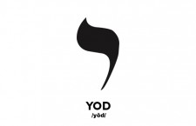
Thesis 8: Each letter is inspired.
    “For truly I say to you, until heaven and earth pass away, not the smallest letter or stroke shall pass from the Law until all is accomplished” (Matt 5:18).
The smallest Hebrew letter is the yod, which looks like an apostrophe. Jesus is saying even the smallest written details—every single letter of Scripture—is inspired by God.

Slide 23
From Thesis 6-8
If every word is inspired down to the smallest letter, then you have:
  Verbal inspiration, i.e., inspiration of words.
  Plenary inspiration, i.e., “full, entire, complete” inspiration.

Slide 24
Thesis 9: The Scriptures are true.
On the one hand, God cannot lie:
    [I]t is impossible for God to lie (Heb 6:18).
    God, who cannot lie (Titus 1:2).

Slide 25
Thesis 9: The Scriptures are true.
On the other hand, God’s Word is true:
    “Your word is truth” (John 17:17).
    “Now, O Lord GOD, You are God, and Your words are truth” (2 Sam 7:28).
    Every word of God proves true (Prov 30:5 ESV).

Slide 26
Thesis 9: The Scriptures are true.
Strictly speaking, only propositions (or claims) are literally true.
    “truth is a characteristic of propositions only. Nothing can be called true in the literal sense of the term except the attribution of a predicate to a subject” (God’s Hammer, p. 25).
A proposition is true if the predicate actually belongs to the subject (i.e., if the proposition corresponds to reality). The proposition, “Snow is white,” is only true if snow is, in fact, white.
Strictly speaking, questions, commands, and are neither true nor false.

Slide 27
Thesis 10: The Scriptures are inerrant.
P1: God’s Word is true in all it teaches, affirms, and implies.
P2: The Bible is God’s written Word.
C: Therefore, the Bible is true in all it teaches, affirms, and implies.
And, of course, if something is true, it cannot be in error, therefore:
P1: Since God’s word is true, it cannot err.
P2: The Bible is God’s word.
C: Therefore, the Bible cannot err.

Slide 28
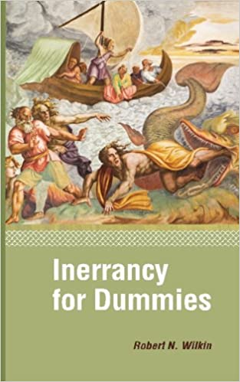
Thesis 10: The Scriptures are inerrant.
Biblical axiom:
The Bible cannot err,
and is true in all it teaches,
affirms, and implies.

Slide 29
What are the options for understanding Biblical inspiration?
A
B
C
D
The Bible contains the word of God.
The Bible becomes the word of God in an encounter.
The Bible is partly the Word of God and partly the words of men.
The Bible is the Word of God.

Slide 30
Four Applications

Slide 31
Application 1: The Bible stands in contrast to all other authorities.
Pastors, teachers, popes, councils, modern-day prophets, and personal spiritual experiences, can all err.
Therefore, they are, by definition, less authoritative than the inerrant Bible.

Slide 32
Application 2: The inspiration and inerrancy of the Bible establishes its canonicity.
The term canon means the rule.
Hence, to say the Bible is canonical is to say the Bible is the rule.
Practically speaking, given the inerrancy of Scripture, every other fallible authority ought to be evaluated by the Bible.

Slide 33
Application 4: Biblical inerrancy makes it possible to have a true worldview.
Worldviews based on fallible authorities are themselves fallible.
By contrast, a worldview deduced from the Bible is true.
Scriptures are profitable for teaching and equipping (2 Tim 3:16-17).

Slide 34
Application 3: The inerrancy of the Word makes assurance of salvation possible.
Most religions in the world makes works a condition of salvation.
Jesus’ gift of eternal life seems too good to be true.
But from Biblical inerrancy, we know promise of eternal life is true and inerrant.
Therefore you can be certain of your present salvation.

Slide 35
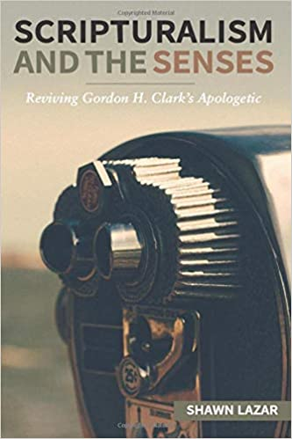
If you want to know how Biblical inspiration influences apologetics…
Gordon H. Clark’s apologetics of Scripturalism begins by assuming the truth of the Word of God.
Clark’s method is to show that while a worldview deduced from the Bible is consistent, other worldviews are self-contradictory.
In this book, I try to revise and improve Clark’s apologetic to answer the critics.

Slide 36
Martin Luther
“Abandon Scripture, and God abandons us to the lies of men.”

