Slide 1

Be Renewed
Ephesians 4:17-24
GRACE EVANGELICAL SOCIETY
National Conference 2019

Slide 2
My new corporate identity
I was born a Canadian citizen
I became a US citizen in Nov 2013
I believe in limited government, personal freedom, & BBQ

Slide 3
My new corporate identity
But I still don’t own a gun, a pickup, cowboy boots, listen to country music, eat Tex-Mex, or watch football
My new corporate identity is still working on changing my mentality and my behavior

Slide 4

By contrast…
My 4-year-old son was born in Texas
He wears cowboy boots with underwear

Slide 5

By contrast…my son’s corporate identity
He wants to own this pickup
with a gun rack
so he can “drive in the mud and shoot animals.”

Slide 6
By contrast…my son’s corporate identity
My son is a redneck
Are rednecks four-year-olds with paychecks?

Slide 7
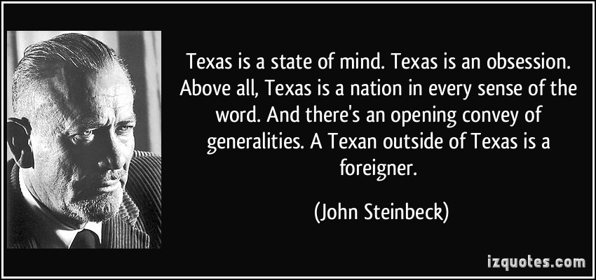
Corporate identities shape the way you live

Slide 8
How does your corporate identity affect your living?
In Ephesians 4:17-24, Paul appeals to the believers’ new corporate identity in Christ, as the basis to change their way of living.

Slide 9
Paul begins with a moral imperative:
“This I say, therefore, and testify in the Lord, that you should no longer walk as the rest of the Gentiles walk” (v 17a).
“no longer” meaning they had

Slide 10
What’s so bad about Gentile living?
“in the futility of their mind, having their understanding darkened, being alienated from the life of God, because of the ignorance that is in them, because of the blindness of their heart; who, being past feeling” (vv 17b-19a)

Slide 11
The Gentiles are…
Spiritually degenerate (“alienated from the life of God”)
Mentally degenerate (“ignorance,” “blindness”)
Emotionally degenerate (“past feeling”)
Overtly degenerate (“given themselves over”)

Slide 12
What is the root problem?
“ in the futility of their mind, having their understanding darkened, being alienated from the life of God, because of the ignorance that is in them, because of the blindness of their heart; who, being past feeling… (vv 17b-19a)

Slide 13
What was the practical result of their sinful mentality?
“ have given themselves over to lewdness, to work all uncleanness with greediness” (vv 19b).
Mental sins lead to overt sins.
Without an eternal perspective, the Gentiles turned to hedonism.
If you think the body is all there is, that’s what you’ll live for

Slide 14
Paul: “You were taught better than that!”

Slide 15
What is the Christian’s advantage?
“ But you have not so learned Christ, if indeed you have heard Him and have been taught by Him, as the truth is in Jesus: ” (vv 20-21).
“If”….and they had
Process: (1) Truth is taught; (2) Truth is heard; (3) Truth is learned.

Slide 16
What did they learn?
“[namely] your having put off according to the former conversation the old man which corrupts itself according to the deceitful lusts; and being renewed in the spirit of your mind; and [your] having put on the new man, which according to God is created in truthful righteousness and holiness” (Darby, vv 22-24).

Slide 17
Having put off and on…
“aorist middle infinite has the idea of an inceptive act that may have reference to conversion. Also, the lexical verbs of putting off and putting on of clothing emphasizes accomplished events rather than the process of activities. The middle voice emphasizes that the subject receives the benefits of his or her action. It is not a reflexive idea, for the person could not do it by his or her own strength. Hence, believers were taught that they have put off or have laid aside the old person at conversion” (Hoehner, Ephesians, 603).

Slide 18
Having put off and on…is positional truth
“The old man is put off and the new man is put on. We are not told to put off the old man by all kinds of endeavors and resolutions; it is already done. The old man was put away by the cross of Christ (Rom 6:6). This is the blessed truth which delivers from doubt and bondage. And then we receive something in Christ, the new man, the new nature. Grace unclothed us and clothed us. Grace made an end of the old man and put upon us the new man. And this new man, after God, is created in righteousness and true holiness, which calls for a corresponding walk” (Gaebelein’s Concise Commentary, p. 999).

Slide 19
What is the “old man”?
Not the flesh, but a corporate identity?
  “It should be observed, however, that the old man now ‘put off’ is not identical with the flesh which, without question, is to abide with each believer to the end of his earthly pilgrimage (Gal. 5:16, 17); but it is rather the first Adamic-relationship which, for the believer, passed out of existence with the death of Christ, being replaced by the New-Creation relationship in Christ, the Last Adam” (Chafer, The Ephesian Letter).

Slide 20
What is the new man?
Not the new born-again nature, but a new corporate identity:
  “For He Himself is our peace, who has made both one, and has broken down the middle wall of separation, having abolished in His flesh the enmity, that is, the law of commandments contained in ordinances, so as to create in Himself one new man from the two, thus making peace, and that He might reconcile them both to God in one body through the cross, thereby putting to death the enmity” (Ephesians 2:14-16 NKJV).

Slide 21
When did this happen to you?
Objectively: at the cross.
    “knowing this, that our old man was crucified with Him, that the body of sin might be done away with, that we should no longer be slaves of sin” (Rom 6:6 NKJV).
Subjectively: at the point of faith.

Slide 22
Putting on and off=aorist tense.
Corruption and renewal=present tense.
“[namely] your having put off according to the former conversation the old man which corrupts itself according to the deceitful lusts; and being renewed in the spirit of your mind; and [your] having put on the new man, which according to God is created in truthful righteousness and holiness” (Darby, vv 22-24).

Slide 23
Two ongoing processes
The corruption of the old man is in the present tense.
  This is evident from the depravity described in vv 17-19.
The renewal of the spirit of the mind is in the present tense (infinitive middle or passive).
  The human spirit and the human mind are distinct (see 1 Cor 14:14, “my spirit prays, but my mind is unfruitful).
  (1) The Holy Spirit uses (2) Bible teaching to (3) work on the born-again human spirit to (4) renew the mind.

Slide 24
If there’s time…
Application: an REBT way to renew your mind
A=Activating Event
B= Beliefs about the Event
C = Consequence (Emotional and Behavioral)
D = Dispute with Doctrine
E = Effect Change

Slide 25
When you’re “in Christ,” think Christ, so you will live Christ.

