Slide 1
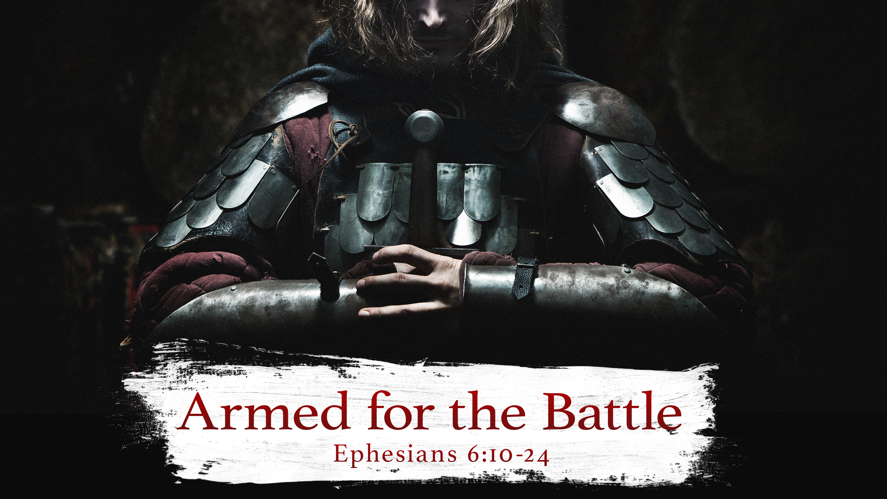

GRACE EVANGELICAL SOCIETY
National Conference 2019
Talking to God- Lesson Fifteen

Slide 2

Armed for the Battle

Slide 3
I. The Armor
II. The Closing

Slide 4
Ephesians
Chapters 1-3 – who we are in Christ
Chapters 4-6 – How we live out who we are in Christ

Slide 5
The Charge

Slide 6
I. The Armor of God – 6:10-20
A. The Charge to Stand – 6:10-11
B. The Reason to Stand – 6:12-13
C. The Items – 6:14-17
D. The Prayer – 6:18-20
II. The Closing – 6:21-24
A. Information – 6:21-22
B. Peace Love Faith and Grace – 6:23-24

Slide 7
I. The Armor
A. The Charge
B. The Reason
C. The Items
D. The Prayer

Slide 8
I. The Armor
A. The Charge

Slide 9
His mighty strength

Slide 10
6:11
Put on the full Armor of God
Lit. clothe yourself with the full Armor of God

Slide 11
Schemes – lit. lies/tricks
The devil is a liar
His methods are lies/tricks/schemes

Slide 12
Unbeliever – never to trust in Jesus Christ
Believer – fail – think we can’t be used

Slide 13
B. The Reason
We are in a spiritual battle

Slide 14
Charge
Be strong in God’s power
How? Put on the Armor of God
Why? So we can stand against the devil/demons so we can stand in the spiritual battle

Slide 15
Repeats the charge

Slide 16
1 Peter 5:8-9
“Be of sober spirit, be on the alert. Your adversary, the devil, prowls about like a roaring lion, seeking someone to devour. But resist him, firm in your faith”

Slide 17
C. The Items – The Armor

Slide 18
The Belt of Truth

Slide 19
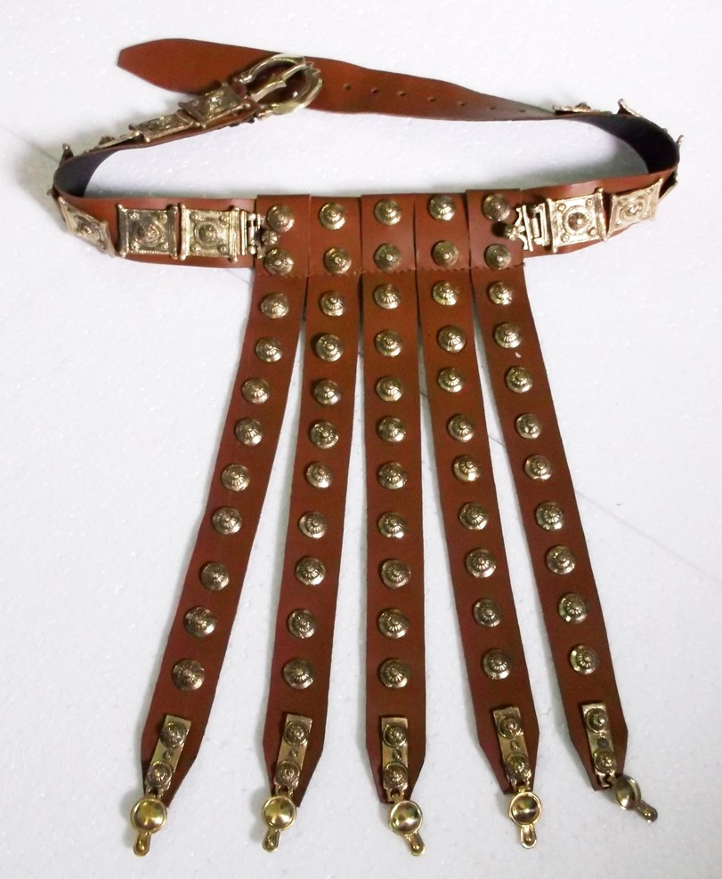

Slide 20
Truth – hold all things together

Slide 21
Mark Twain
“A lie can travel half way around the world while the truth is putting on its shoes.”

Slide 22
Satan’s lies
Sin will not hurt you
God doesn’t love you
Works can save you

Slide 23
Three areas of truth
1. Jesus Christ is truth – John 14:6
2. God’s Word is truth – John 17:17
3. Holy Spirit is called the Spirit of truth – John 14:17

Slide 24
Breastplate of Righteousness

Slide 25
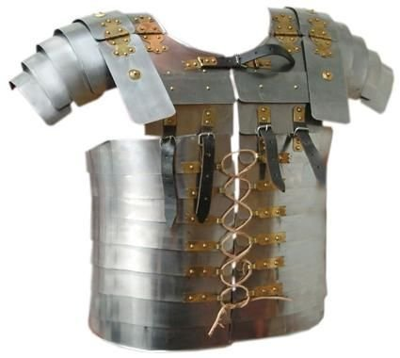

Slide 26
Two aspects of righteousness

Slide 27
1. God has given to every believer righteousness
Phil 3:9
Rom. 4:5

Slide 28
2. We are to live out this righteousness daily
Titus 2:12
Deny ungodliness – live righteously

Slide 29
Stand
In truth against the liar
In righteousness against the evil one

Slide 30
Gospel of Peace

Slide 31
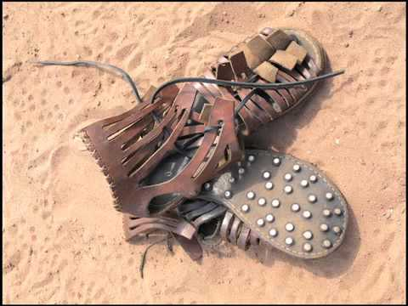
Font color, size, and style for text slides
Subtext font style for text slides

Slide 32
The Gospel

Slide 33
The church today announces the good life instead of the good news

Slide 34
Paul Harvey
“Too many Christians are no longer fishers of men but keepers of the aquarium.”

Slide 35
Rom. 5:1
We have peace with God through Jesus Christ

Slide 36
Truth against the liar
Righteousness against the evil one
Good news against the false news

Slide 37
Shield of Faith

Slide 38
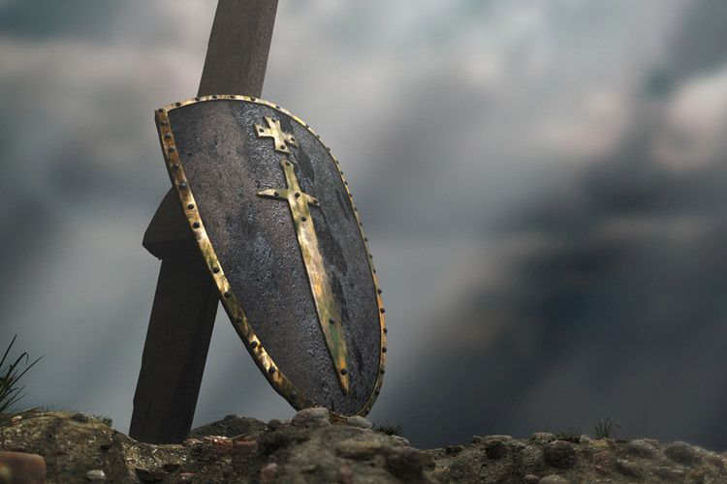
Font color, size, and style for text slides
Subtext font style for text slides

Slide 39
Shield of faith stops things from hurting us

Slide 40
Faith is taking God at His Word

Slide 41
We take up the shield of faith as we believe God’s Word and hold to the promises and principles found in the Word

Slide 42
Faith is the shield when the trials, temptations, hardships, and doubts come

Slide 43
Rom. 8:28 – All things working for good
Heb. 13 – Never leave why fear
Phil. 4:19 – Supply all our needs
Phil. 4:13 – Do all things

Slide 44
The Helmet of Salvation

Slide 45
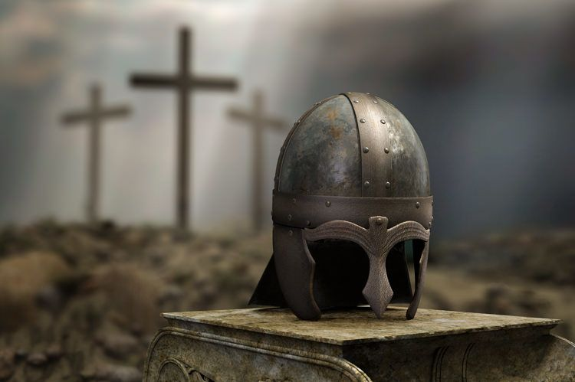
Text
Subtext

Slide 46
God totally saves us

Slide 47
Past
Present
Future

Slide 48
1. Saved from the guilt and penalty of sin
Past

Slide 49
2. Saved us from the power of sin
Present

Slide 50
3. He will save us from even the presence of sin
Future

Slide 51
The Sword – The Word of God

Slide 52
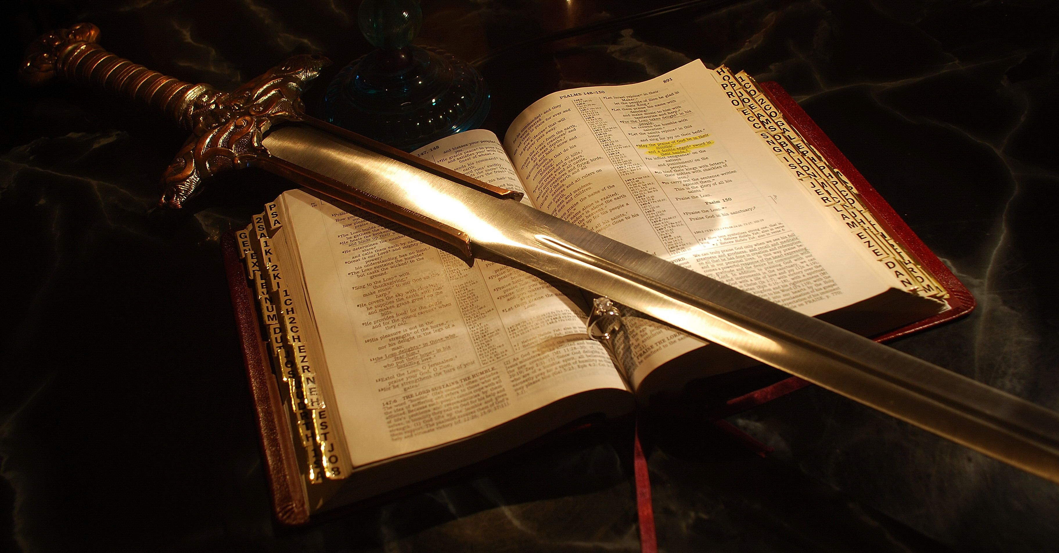
Text
Subtext

Slide 53
Two-edged sword
Maxhaira – Roman soldiers

Slide 54
Hebrews 4:12

Slide 55
Many books can inform but only the Bible can transform

Slide 56
Know the Word – 2 Tim. 2:15
Apply the Word – Phil. 4:9
Proclaim the Word – 2 Tim. 4:2
Teach the Word – 2 Tim. 2:2
Memorize the Word – Psalm 119:11

Slide 57
Romans 13:14
“But put on the Lord Jesus Christ, and make no provision for the flesh in regard to its lusts.”

Slide 58
Jesus Christ is the way and truth
He is our righteousness
He is the good news message
He is the One in which we have faith
He brings salvation
He is the Word

Slide 59
Prayer

Slide 60
Four things
What
When
How
Who

Slide 61
What
Keep on praying

Slide 62
When
At all times

Slide 63
How
In the Spirit

Slide 64
What – pray
When – at all times
How – power of the Holy Spirit – alert and keeping on

Slide 65
For whom
For all the saints – fellow believers

Slide 66
II. The closing

Slide 67
A. Information

Slide 68
1. Know about us
2. Be comforted – we are doing fine

Slide 69
B. Peace, love, faith, and grace

Slide 70
Peace to the brothers

Slide 71
Love
Love of God through Jesus Christ

Slide 72
With faith – trusting God

Slide 73
Grace

Slide 74
Grace
Unmerited favor from God

Slide 75
Let us put on the Armor of God
Why? Stand against the devil and the fallen world – be strong
Truth, righteousness, gospel, faith, salvation and Word of God
Praying for each other

