Slide 1

Ephesians 3:14–4:6
Glory In The Church Forever
GRACE EVANGELICAL SOCIETY
National Conference 2019

Slide 2
How do you pray?

Slide 3
How do you pray?
How much time do you spend praying for physical needs?

Slide 4
How do you pray?
How much time do you spend praying for physical needs?
How much time do you spend praying for the inner spiritual needs of your fellow believers?

Slide 5
How do you pray?
How much time do you spend praying for physical needs?
How much time do you spend praying for the inner spiritual needs of your fellow believers?
How much time do you spend praying that individual believers would grow spiritually so that the church can be successful?

Slide 6
Paul’s Prayer
¹⁴ For this reason I kneel before the Father ¹⁵ from whom every family in heaven and on earth is named.

Slide 7
Paul’s Prayer
¹⁶ I pray that He may grant you, according to the riches of His glory, to be strengthened with power in the inner man through His Spirit…

Slide 8
Paul’s Prayer
¹⁶ I pray that He may grant you… to be strengthened with power in the inner man through His Spirit,

Slide 9
Paul’s Prayer
¹⁶ I pray that He may grant you… to be strengthened with power in the inner man through His Spirit,
What is He talking about?

Slide 10
Paul’s Prayer
¹⁶ I pray that He may grant you… to be strengthened with power in the inner man through His Spirit,
I pray that …your mind may be enlightened so you may know …what is the immeasurable greatness of His power to us who believe, according to the working of His vast strength. (Eph 1:18-20)

Slide 11
Paul’s Prayer
¹⁶ I pray that He may grant you… to be strengthened with power in the inner man through His Spirit,
I pray that …your mind may be enlightened so you may know …what is the immeasurable greatness of His power to us who believe, according to the working of His vast strength. (Eph 1:18-20)

Slide 12
Paul’s Prayer
¹⁶ I pray that He may grant you… to be strengthened with power in the inner man through His Spirit,
Finally, my brethren, be strong in the Lord and in the power of His might. Put on the full armor of God. (Eph 6:9-11)

Slide 13
Paul’s Prayer
¹⁶ I pray that He may grant you… to be strengthened with power in the inner man through His Spirit,
Finally, my brethren, be strong in the Lord and in the power of His might. Put on the full armor of God. (Eph 6:9-11)

Slide 14
Paul’s Prayer
¹⁶ I pray that He may grant you… to be strengthened with power in the inner man through His Spirit,
Put on the full armor of God: truth… salvation… righteousness… Word of God… Prayer… Perseverance… (Eph 6:14-18)

Slide 15
¹⁶ …be strengthened with power in the inner man through His Spirit…

Slide 16


Slide 17
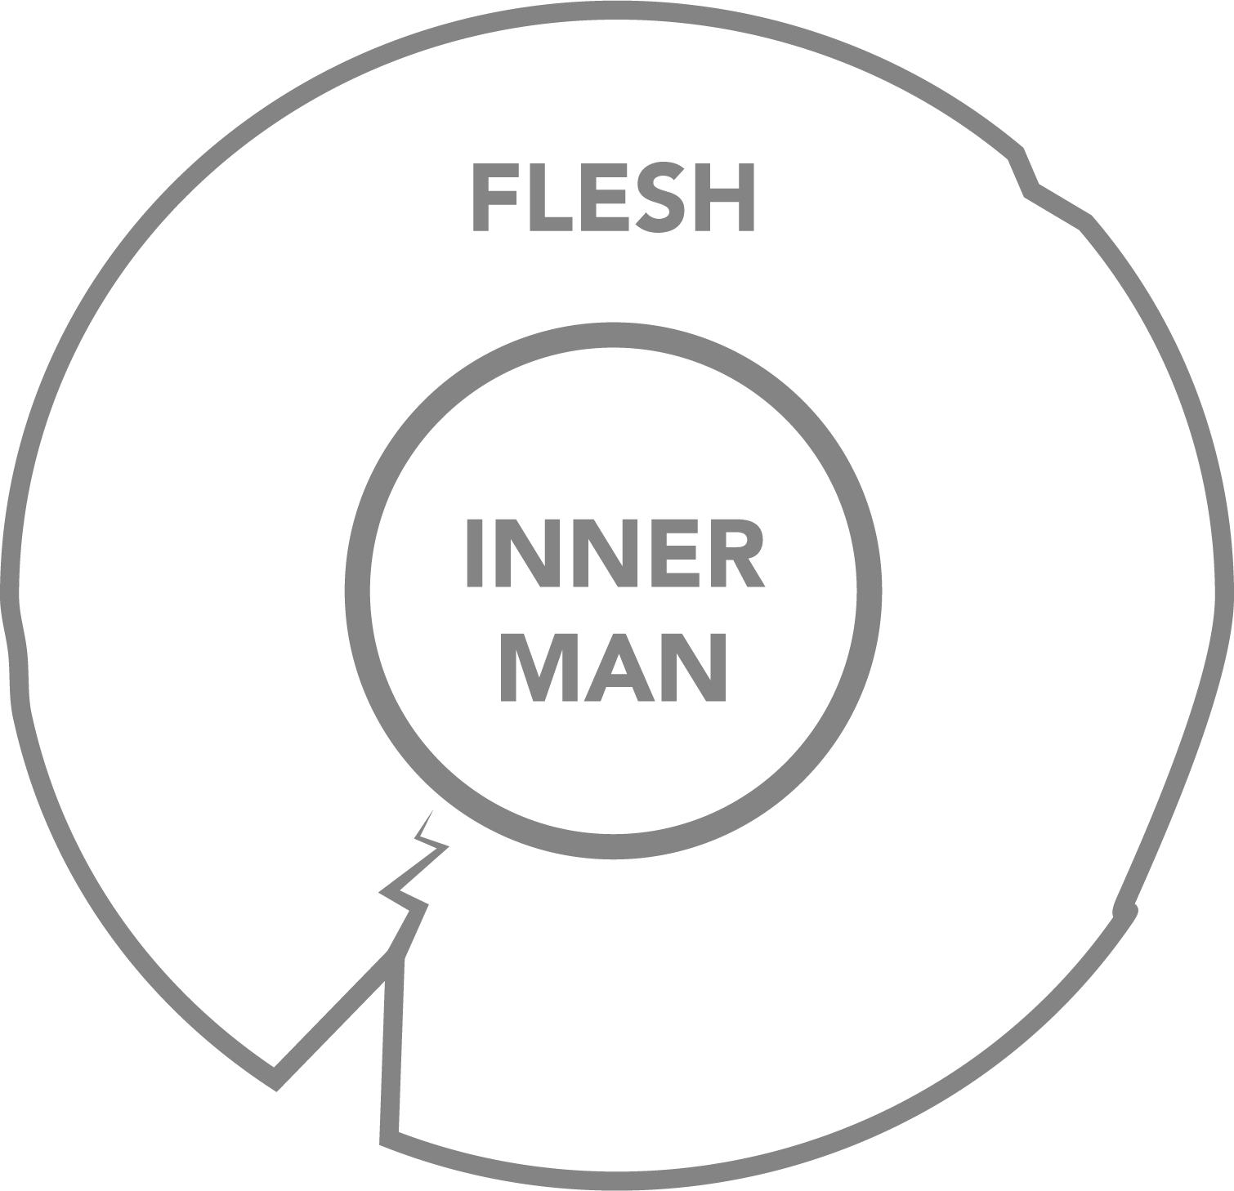

Slide 20


Slide 21


Slide 25


Slide 26


Slide 27


Slide 28


Slide 29


Slide 31
¹⁶ …be strengthened with power in the inner man through His Spirit…

Slide 32
¹⁶ …be strengthened with power in the inner man through His Spirit…
Means: God provides the inner power we need to have transformed lives.

Slide 33
Paul’s Prayer
¹⁷ and that Christ may dwell in your hearts through faith…

Slide 34
Paul’s Prayer
¹⁷ and that Christ may dwell in your hearts through faith…
Ask Jesus into your heart?

Slide 35
Paul’s Prayer
¹⁷ and that Christ may dwell in your hearts through faith…
What does this mean?

Slide 36
A Seeming Contradiction
¹⁷ and that Christ may dwell in your hearts through faith…
…the Holy Spirit of God, by whom you were sealed for the day of redemption. (Eph 4:30)

Slide 37
A Seeming Contradiction
¹⁷ and that Christ may dwell in your hearts through faith…
Now He …has sealed us and given us the Spirit in our hearts as a guarantee. (1 Cor 1:22-23)

Slide 38
A Seeming Contradiction
¹⁷ and that Christ may dwell in your hearts through faith…
Now He …has sealed us and given us the Spirit in our hearts as a guarantee. (1 Cor 1:22-23)

Slide 39
A Seeming Contradiction
¹⁷ and that Christ may dwell in your hearts through faith…
Becoming the dwelling place of the Holy Spirit is IMMEDIATE.

Slide 40
A Seeming Contradiction
¹⁷ and that Christ may dwell in your hearts through faith…
If Paul is talking to believers, why does he imply that Christ does not yet dwell in their hearts?

Slide 41
A Seeming Contradiction
¹⁷ and that Christ may dwell in your hearts through faith…
The whole building, being put together by Him, grows into a holy sanctuary in the Lord. You also are being built together for God’s dwelling in the Spirit. (Eph 2:21-22)

Slide 42
A Seeming Contradiction
¹⁷ and that Christ may dwell in your hearts through faith…
The whole building, being put together by Him, grows into a holy sanctuary in the Lord. You also are being built together for God’s dwelling…. (Eph 2:21-22)

Slide 43
A Seeming Contradiction
¹⁷ and that Christ may dwell in your hearts through faith…
The whole building, being put together by Him, grows into a holy sanctuary in the Lord. You also are being built together for God’s dwelling... (Eph 2:21-22)

Slide 44
A Seeming Contradiction
¹⁷ and that Christ may dwell in your hearts through faith…
Becoming a dwelling place for the God is a PROCESS.

Slide 45
BUT WAIT!
Becoming the dwelling place of the Holy Spirit is IMMEDIATE.
Becoming a dwelling place for God is a PROCESS.

Slide 46
IMMEDIATE:
The Father… will give you another Helper, that He may abide with you forever— ¹⁷ the Spirit of truth… He dwells with you and will be in you. (John 14:16-17)

Slide 47
IMMEDIATE:
The Father… will give you another Helper, that He may abide with you forever— ¹⁷ the Spirit of truth… He dwells with you and will be in you. (John 14:16-17)
PROCESS:
If anyone loves Me, he will keep My word; and My Father will love him, and We will come to him and make Our home with him. (John 14:23)

Slide 48
IMMEDIATE:
The Father… will give you another Helper, that He may abide with you forever— ¹⁷ the Spirit of truth… He dwells with you and will be in you. (John 14:16-17)
PROCESS:
If anyone loves Me, he will keep My word; and My Father will love him, and We will come to him and make Our home with him. (John 14:23)

Slide 49
IMMEDIATE: HOLY SPIRIT DWELLS
The Father… will give you another Helper, that He may abide with you forever— ¹⁷ the Spirit of truth… He dwells with you and will be in you. (John 14:16-17)
PROCESS: TRINITY DWELLS
If anyone loves Me, he will keep My word; and My Father will love him, and We will come to him and make Our home with him. (John 14:23)

Slide 50
A Seeming Contradiction
¹⁷ and that Christ may dwell in your hearts through faith…

Slide 51
A Seeming Contradiction
¹⁷ and that Christ may dwell in your hearts through faith…

Slide 52
A Seeming Contradiction
¹⁷ and that Christ may dwell in your hearts through faith…
Is this saving faith?

Slide 53
A Seeming Contradiction
¹⁷ and that Christ may dwell in your hearts through faith…
You have been saved through faith…(Eph 2:8)

Slide 54
A Seeming Contradiction
¹⁷ and that Christ may dwell in your hearts through faith…
The life which I now live in the flesh I live by faith in the Son of God… (Gal 2:20)

Slide 55
A Seeming Contradiction
¹⁷ and that Christ may dwell in your hearts through faith…
The life which I now live in the flesh I live by faith in the Son of God... (Gal 2:20)

Slide 56


Slide 57
Paul’s Prayer
¹⁷ …I pray that you, being rooted and firmly established in love, ¹⁸ may be able to comprehend with all the saints what is the length and width, height and depth of God’s love, ¹⁹ and to know the Messiah’s love that surpasses knowledge, so you may…

Slide 58
Paul’s Prayer
¹⁹ …so you may… be filled with all the fullness of God.

Slide 59
Paul’s Prayer
¹⁹ …so you may… be filled with all the fullness of God.
Can an individual be filled with the fullness of God?

Slide 60
Paul’s Prayer
¹⁹ …so you may… be filled with all the fullness of God.
Can an individual be filled with the fullness of God? …No!

Slide 61
Paul’s Prayer
¹⁹ …so you may… be filled with all the fullness of God.

Slide 62
Paul’s Prayer
¹⁹ …so you (plural) may… be filled with all the fullness of God.

Slide 63
Paul’s Prayer
¹⁹ …so you may… be filled with all the fullness of God.
…the church… is His body, the fullness of the One who fills all things in every way. (Eph 1:22-23)

Slide 64
Paul’s Prayer
¹⁹ …so you may… be filled with all the fullness of God.
…the church… is His body, the fullness of the One who fills all things in every way. (Eph 1:22-23)

Slide 65
Paul’s Prayer
¹⁹ …so you may… be filled with all the fullness of God.
He… ascended… that He might fill all things. And He Himself gave some to be apostles… prophets… evangelists… pastors… teachers… for the edifying of the body of Christ, till we all come to the …measure of the stature of the fullness of Christ… (Eph 4:10-13)

Slide 66
Paul’s Prayer
¹⁹ …so you may… be filled with all the fullness of God.
He… ascended… that He might fill all things. And He Himself gave some to be apostles… prophets… evangelists… pastors… teachers… for the edifying of the body of Christ, till we all come to the …measure of the stature of the fullness of Christ… (Eph 4:10-13)

Slide 67
Paul’s Prayer
¹⁹ …so you (plural) may… be filled with all the fullness of God.
It’s the church that is filled with all the fullness of God. (Not isolated individual believers.)

Slide 68
Paul’s Prayer
²⁰ Now to Him who is able to do above and beyond all that we ask or think according to the power that works in us— ²¹ to Him be glory in the church and in Christ Jesus to all generations, forever and ever. Amen

Slide 69
Paul’s Instructions
4:1 Therefore I, the prisoner for the Lord, urge you to walk worthy of the calling you have received, ² with all humility and gentleness, with patience, accepting one another in love, ³ diligently keeping the unity of the Spirit with the peace that binds us.

Slide 70
Paul’s Rationale
⁴ There is one body and one Spirit—just as you were called to one hope at your calling— ⁵ one Lord, one faith, one baptism, ⁶ one God and Father of all, who is above all and through all and in all.

Slide 71
How do you pray?
How much time do you spend praying that individual believers would grow spiritually so that the church can be successful?

Slide 72
How do you pray?
How much time do you spend praying that individual believers would grow spiritually so that the church can be successful?
How much time do you spend focusing on your own spiritual health, so that you can play your part in making the church successful?

